Slide 1
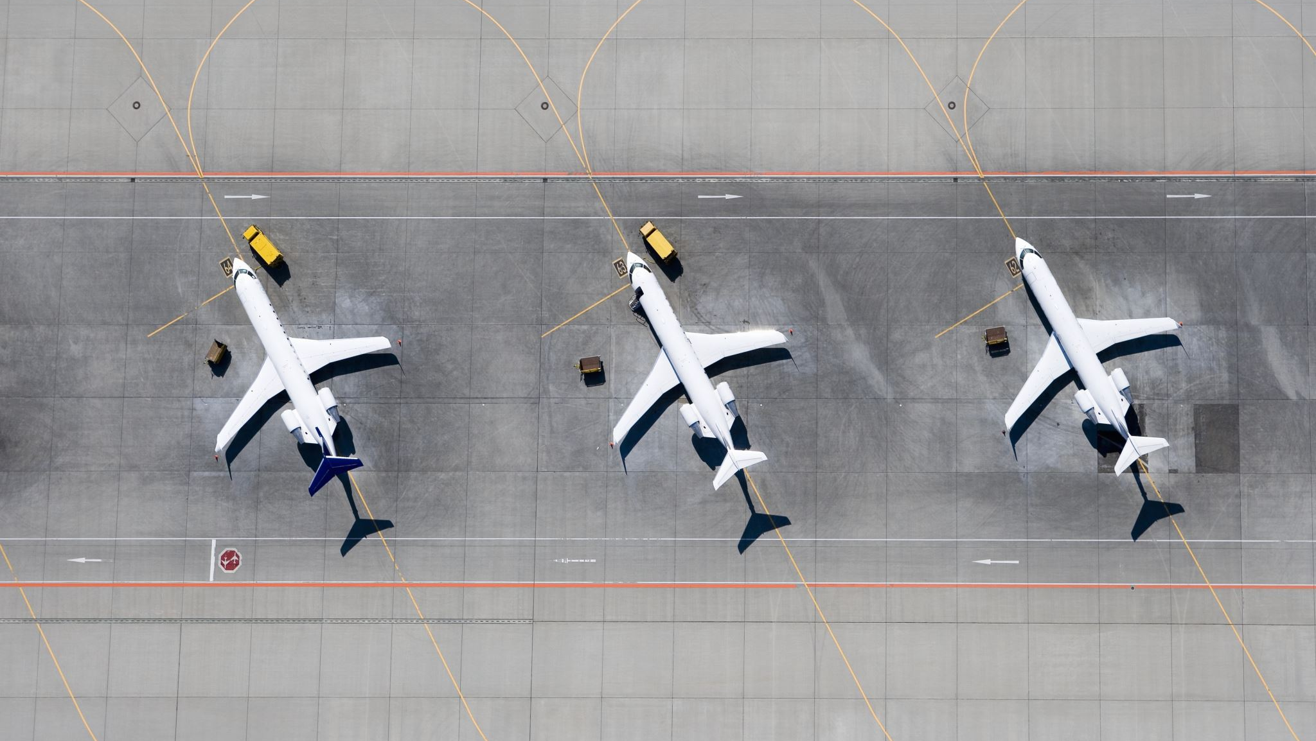
Air Traffic Incidents 2000-2022
Ben MacDonald, CW2

Slide 2

Intro
Dataset:
Individual aircraft incidents and associated factors
Data Types:
Categorical (required significant cleaning to be useable)
Exclusions:
Ground casualty figures (most were purely coincidental)
Flight Types:
Passenger, cargo, private, military

Slide 3
Intro
Dataset:
Individual aircraft incidents and associated factors
Time Period:
2000 to 2022
Data Types:
Categorical (required significant cleaning to be useable)
Exclusions:
Ground casualty figures (most were purely coincidental)
Flight Types:
military, private, passenger, and cargo

Slide 4
Air Traffic Incidents by the numbers
Average flights per year (2000-2022): 28.3 million
Average incidents per year: 215
Non-fatal incidents: 73.6%
Fatal incidents: 26.4%
Total occupant loss: 67.3%
Partial loss: 32.7%

Slide 5
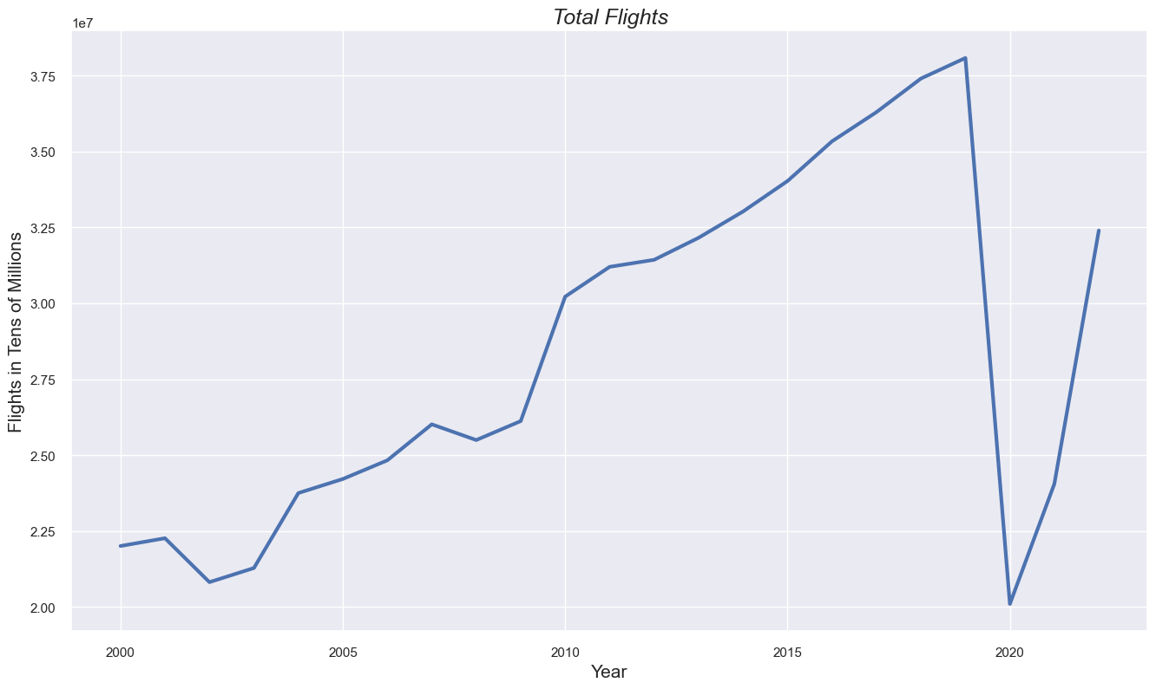
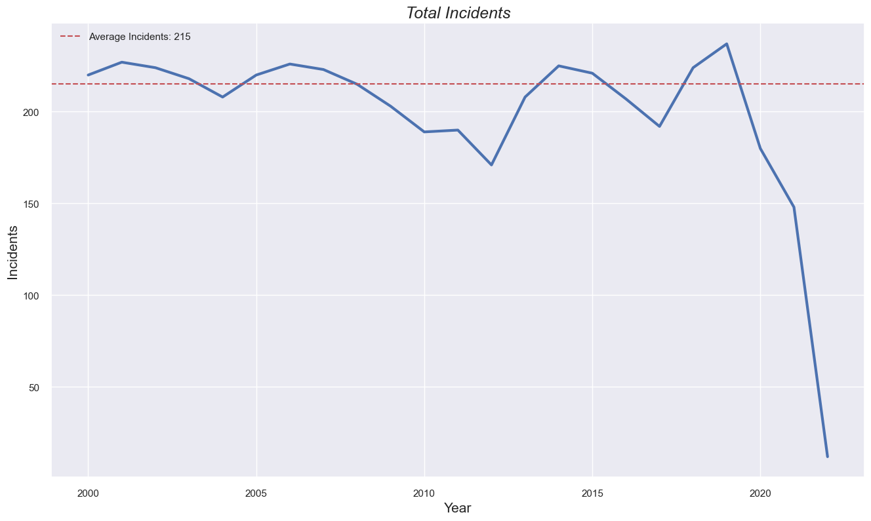
Air Traffic Incidents by the numbers
Covid-19
Covid-19

Slide 6
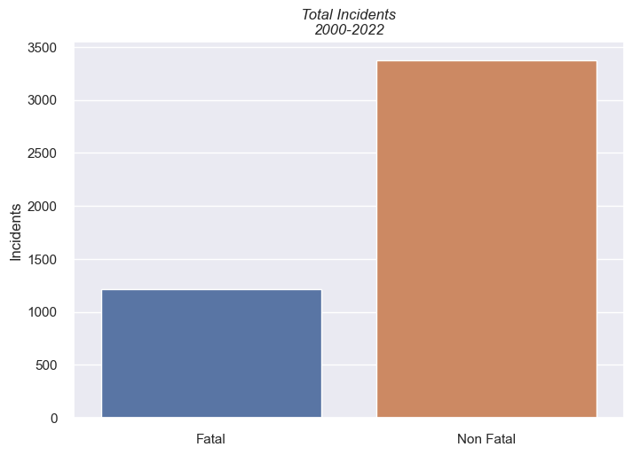
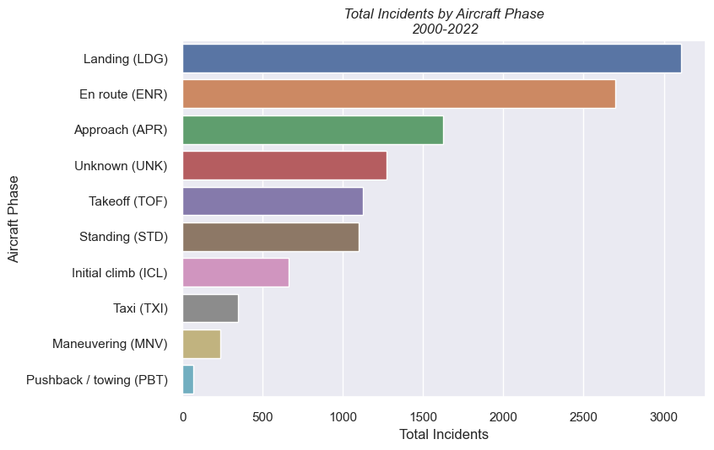
Air Traffic Incidents by the numbers
73.6% of incidents were not fatal
26.4% were fatal
Most incidents occur during flight and landing phases

Slide 7
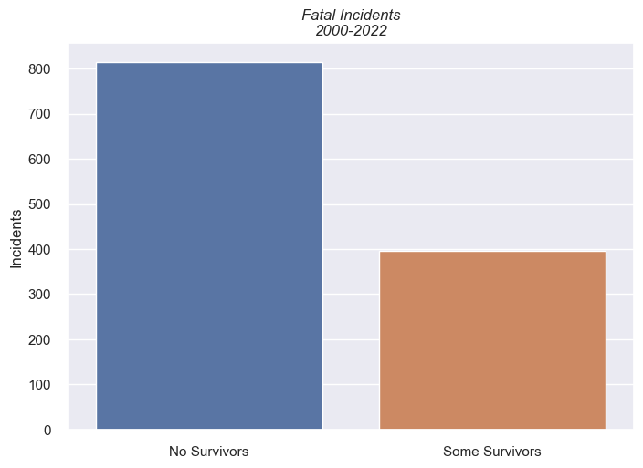
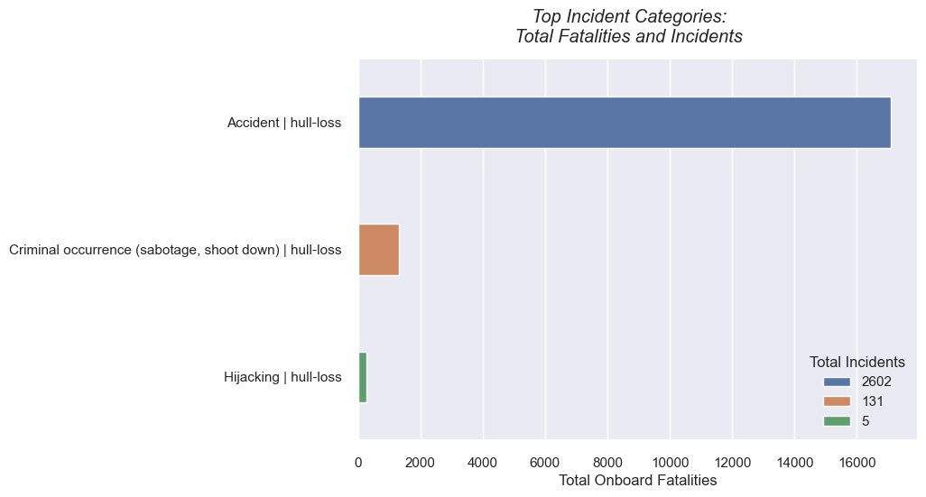
Air Traffic Incidents by the numbers
67% of fatal incidents had no survivors
33% had some
Most incidents were categorized as accidental

Slide 8
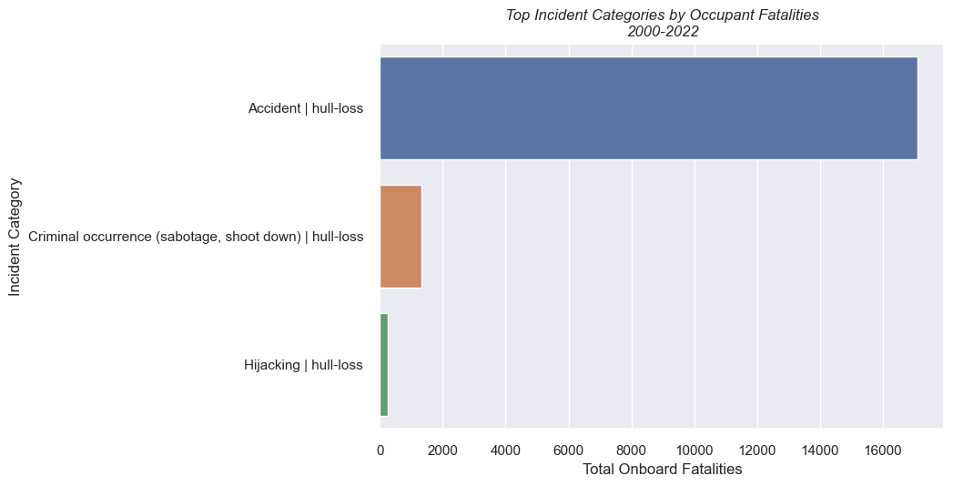
Air Traffic Incidents by the numbers

Slide 9
Hypotheses
Null:
Incident causes have no influence on fatal occurrences
Alternate:
Incident causes have a significant influence on fatal occurrences

Slide 10
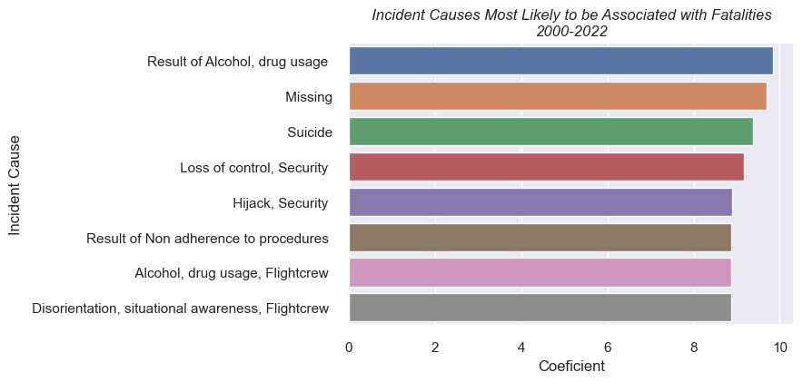
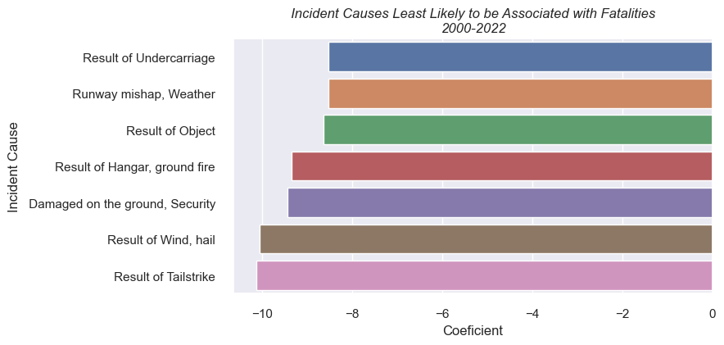

Hypothesis revisited
Null:
Incident causes have no influence on fatal occurrences
Alternate:
Incident causes have a significant influence on fatal occurrences
x

Slide 11
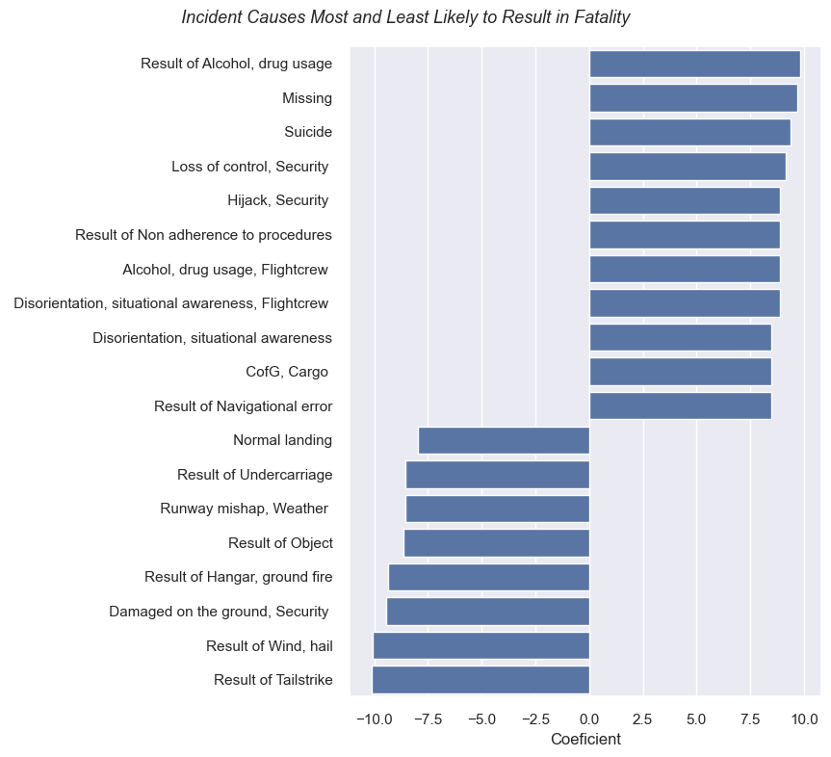
Hypotheses revisited
Most Likely
Null:
Incident causes have no influence on fatal occurrences
Alternate:
Incident causes have a significant influence on fatal occurrences
x
Least Likely

Slide 12

Key Findings
Air travel is very safe
Most accidents do not result in fatalities
When there are fatalities, there tends to be a total loss of occupants
Incident causes are a statistically strong predictor of whether an incident will result in fatalities or not

Slide 13

Information
GitHub Repository:
https://github.com/b-macd/Air_Travel_Safety_Analysis
Datasets:
https://www.kaggle.com/datasets/deepcontractor/aircraft-accidents-failures-hijacks-dataset
https://data.worldbank.org/indicator/IS.AIR.DPRT
Contact:
benjamin.t.macdonald.mil@army.mil

Slide 14
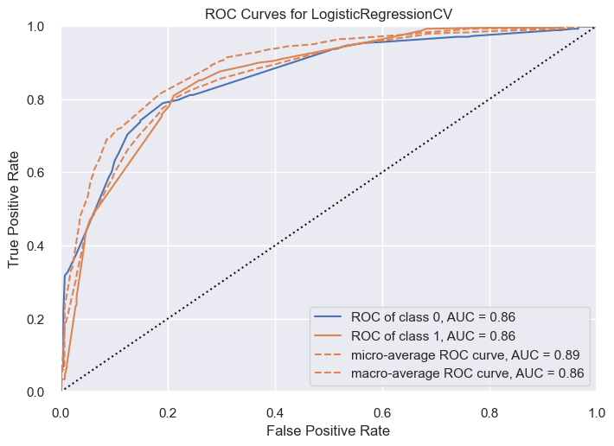
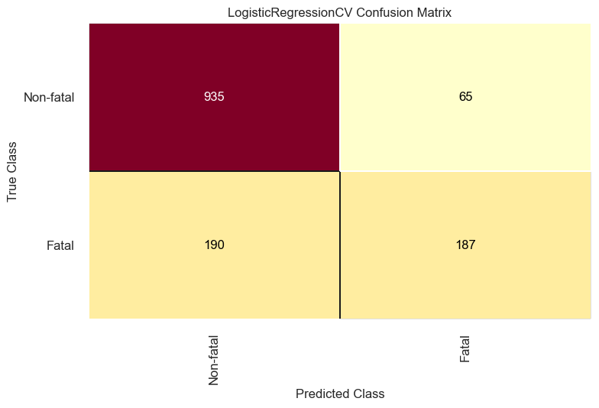
Appendix

Slide 15
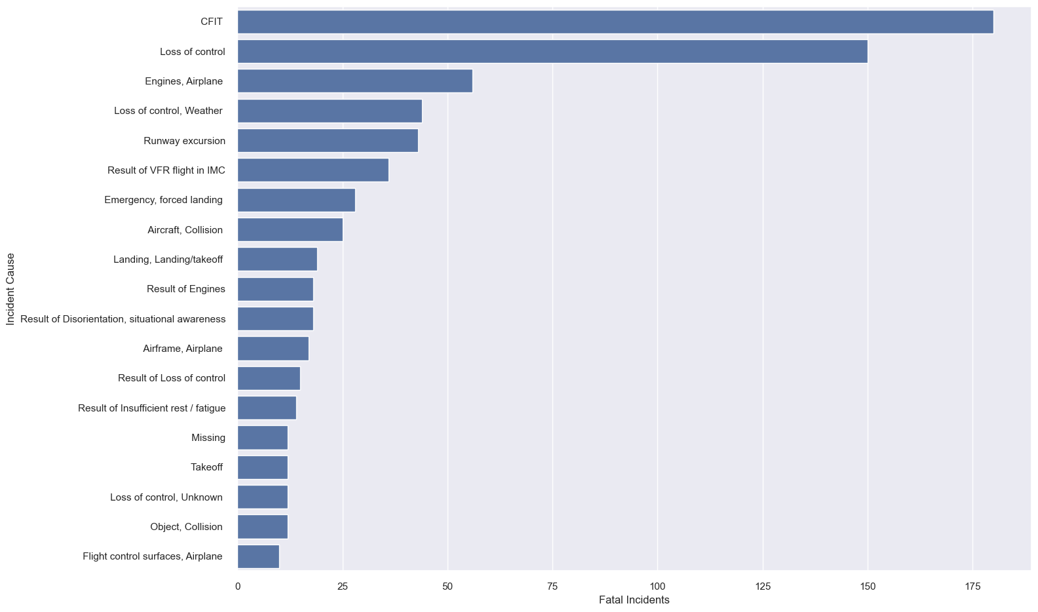
Appendix

